Slide 1
COMP 2406
Here we look at modularizing javascript with modules including using imported npm modules.

Slide 2
Javascript Modules in Node.js
Node.js provides three kinds of modules
core modules –ship with node.js
file based modules –loaded from local file system
imported from npm registry
Server-side
Here we are talking about modularizing server-side javascript for execution in node.js environment.
Here we don't talk about modularizing client-side javascript shipped to the browser.
References: Beginning Node.js Copyright © 2014 by Basarat Ali Syed
Syed, Basarat Ali (2014-11-28). Beginning Node.js . Apress. Chapter 4

Slide 3
COMP 2406
Core Modules and Imported Node Modules
require('bar');
look for core modules with the same name, for example, bar
If no core module matching this name is found, we look for an imported node_module called 'bar'.
Syed, Basarat Ali (2014-11-28). Beginning Node.js (p. 65). Apress Chapter 4

Slide 4
COMP 2406
File based modules (our own modules)
require('./bar);
require('../bar/bar');
require('/full/path/to/a/node/module/file');
File-based module is loaded from the specified path

Slide 5
COMP 2406
Scanning order for Imported Node Modules
/home/ryo/project/node_modules/bar.js
/home/ryo/node_modules/bar.js
/home/node_modules/bar.js
/node_modules/bar.js
In other words, Node.js looks for 'node_modules/bar.js' in the current folder followed by every parent folder until it reaches the root of the file system tree for the current file or until a bar.js is found.
[Syed, Basarat Ali (2014-11-28). Beginning Node.js (p. 66). Apress. Kindle Edition.]

Slide 6
COMP 2406
Simulating Imported Node Modules
// home/foo.js
var bar = require('bar');
bar(); // hello node_modules!
// home/node_modules/bar.js
module.exports = function () {
console.log(' hello node_modules!');
}
Syed, Basarat Ali (2014-11-28). Beginning Node.js (p. 66). Apress.

Slide 7
COMP 2406
As local file Modules
// home/foo.js
var bar = require('./bar');
bar(); // hello node_modules!
// home/bar.js
module.exports = function () {
console.log(' hello node_modules!');
}
Syed, Basarat Ali (2014-11-28). Beginning Node.js (p. 66). Apress.

Slide 8
index.js
implicit file: index.js
It is common to have a several files working toward a singular goal.
Node.js has explicit support for this mechanism.
If a path to the module resolves to a folder (instead of a file), Node.js will look for an index.js file in that folder and return that as the module file.
[Syed, Basarat Ali (2014-11-28). Beginning Node.js (p. 66). Apress. Kindle Edition. chap 4]

Slide 9
implicit loading of index.js
//bar/bar1.js
module.exports = function () {
console.log('bar1 was called'); }
//bar/bar2.js
module.exports = function () {
console.log('bar2 was called'); }
//bar/index.js
exports.bar1 = require('./bar1');
exports.bar2 = require('./bar2');
//foo.js
var bar = require('./bar');
bar.bar1();
bar.bar2();
[Syed, Basarat Ali (2014-11-28). Beginning Node.js (pp. 66-67). Apress. Kindle Edition. Chapter 4]

Slide 10
implicit loading of index.js from node_modules
//node_modules/bar/bar1.js
module.exports = function () {
console.log(' bar1 was called'); }
//node_modules/bar/bar2.js
module.exports = function () {
console.log(' bar2 was called'); }
//node_modules/bar/index.js
exports.bar1 = require('./bar1');
exports.bar2 = require('./bar2');
//foo.js
var bar = require('bar'); //node_modules module bar
bar.bar1();
bar.bar2();
[Syed, Basarat Ali (2014-11-28). Beginning Node.js (p. 67). Apress. Kindle Edition. Chap. 4]

Slide 11
using implicit loading of index.js from node_modules
foo/foo.js //provides utilities you
bar/bar.js
require('../foo/foo.js')
bar/sub1/sub2/file.js
require('../../../foo/foo.js')
//better idea:
/node_modules/foo/index.js
//in each file:
require('foo')
Syed, Basarat Ali (2014-11-28). Beginning Node.js (p. 68). Apress. Kindle Edition. Chap 4

Slide 12
Module Incompatibility
In Node.js, each module can have its own node_modules folder and different versions of moduleZ can coexist.
Modules do not need to be global in Node.js
Syed, Basarat Ali (2014-11-28). Beginning Node.js (p. 69). Apress. Kindle Edition. Chap 4

Slide 13
Node will Cache Modules
projectroot
|--
node_modules/foo/index.js
|-- moduleA/ a.js
|-- moduleB/ b.js
If a.js and b.js both require('foo') they will get the same cached module export result.
Syed, Basarat Ali (2014-11-28). Beginning Node.js (p. 69). Apress. Kindle Edition. Chap. 4

Slide 14
Own versions of Modules
projectroot
|--
node_modules/foo/index.js
|-- moduleA/a.js
|-- moduleB
|--
node_modules/foo/index.js
|-- b.js
If a.js and b.js both require('foo') this time they will get the different versions of module foo.
Syed, Basarat Ali (2014-11-28). Beginning Node.js (p. 69). Apress. Kindle Edition. Chap. 4

Slide 15
Implicit Loading of JSON objects
In Node.js, if a foo.js is not found as a result of a require('foo'), Node.js will look for a foo.json
foo.json will be treated as a JSON string and converted to a javascript object and returned as the export of the module.
Popular mechanism for configuration data.
Syed, Basarat Ali (2014-11-28). Beginning Node.js (p. 69). Apress. Kindle Edition. Chap 4

Slide 16
Implicit Loading of JSON objects
//config.json
{"foo": "this is the value for foo"}
//app.js
var config = require('./config');
console.log(config.foo); //this is the value for foo
Syed, Basarat Ali (2014-11-28). Beginning Node.js (p. 69). Apress. Kindle Edition. Chap 4

Slide 17
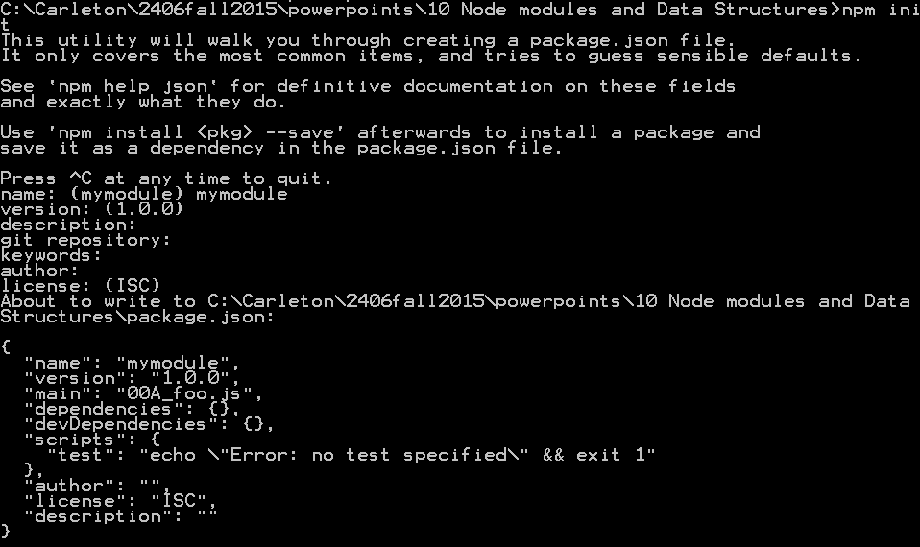
Creating a package.json depedencies file
npm init

Slide 18
Creating a package.json depedencies file
npm init
{
"name": "mymodule",
"version": "1.0.0",
"description": "",
"main": "00A_foo.js",
"dependencies": {},
"devDependencies": {},
"scripts": {
"test": "echo \"Error: no test specified\" && exit 1"
},
"author": "",
"license": "ISC"
}

Slide 19
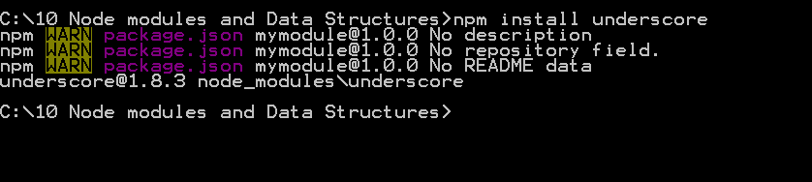
Installing an npm package
npm install underscore
{
"name": "mymodule",
"version": "1.0.0",
"main": "00A_foo.js",
"dependencies": {},
"devDependencies": {},
"scripts": {
"test": "echo \"Error: no test specified\" && exit 1"
},
"author": "",
"license": "ISC",
"description": ""
}
No effect on package.json

Slide 20
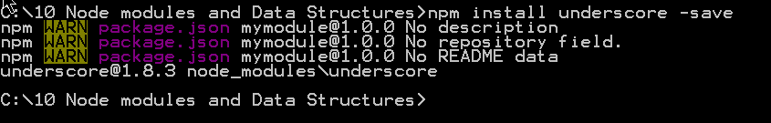
Installing an npm package (with -save or --save option)
npm install underscore –save //or --save
{
"name": "mymodule",
"version": "1.0.0",
"main": "00A_foo.js",
"dependencies": {
"underscore": "^1.8.3"
},
"devDependencies": {},
"scripts": {
"test": "echo \"Error: no test specified\" && exit 1"
},
"author": "",
"license": "ISC",
"description": ""
}
Updates
package.json

Slide 21
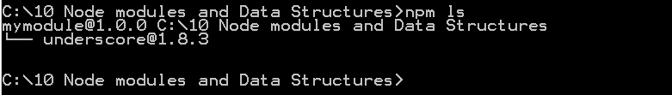
Listing installed dependencies
npm ls

Slide 22
Removing depedencies
npm rm underscore
//or
npm rm underscore –save //to update package.json

Slide 23
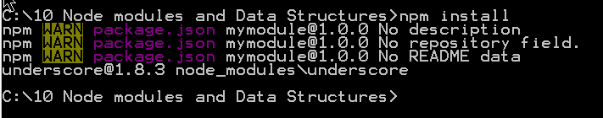
Installing all depencies in your package.json
npm install //installs from package.json
{
"name": "mymodule",
"version": "1.0.0",
"main": "00A_foo.js",
"dependencies": {
"underscore": "^1.8.3"
},
"devDependencies": {},
"scripts": {
"test": "echo \"Error: no test specified\" && exit 1"
},
"author": "",
"license": "ISC",
"description": ""
}
Will install all dependencies listed in
package.json

Slide 24
npm Semantic Versioning
Npm uses the following Semantic (meaningful) version numbering scheme
1.8.3
Major version number
Must be incremented when a non-backwards compatible feature is added or a non-backwards compatible bug fix is made
Minor version number
Must be incremented when a
backwards compatible feature is added
Patch version must be incremented when a backwards compatible bug fix is made

Slide 25
npm Semantic Versioning
Npm uses the following Semantic (meaningful) version numbering scheme
~1.8.3
~ means latest patch compatible version
e.g. 1.8.5
But not
1.9.0 or 2.0.1

Slide 26
npm Semantic Versioning
Npm uses the following Semantic (meaningful) version numbering scheme
^1.8.3
^ means latest minor version compatible version
e.g. 1.9.5
but not 2.0.1

Slide 27
npm Semantic Versioning –other options
Npm uses the following Semantic (meaningful) version numbering scheme
1.8.*
>=1.8.9
<2.0.3
* //latest version

Slide 28
Installing specific versions
> npm install underscore@1.0.3
> npm install underscore@"~1.0.0"
> npm install underscore@"^1.0.0"
> npm install underscore //latest version

Slide 29
Installing specific versions –with package.json
//in package.json
"dependencies": {
"underscore": "^1.6.0"
}
npm install
//Or to update package.json
npm install underscore@"^1.0.0" –save
Or to update package.json
$ npm update -save

Slide 30
npm includes installing global modules with –g option
npm install -g browserify
Intended for installing modules that provide
command line tools
Not intended for modules you require() with your code

Slide 31
package.json has a special main property for loading files
package.json does provide one special main property for loading file system modules. (There can only be one main however.)
|-- app.js
|-- node_modules
|-- foo
|-- package.json
|-- lib
|-- main.js
//package.json
{ "main" : "./lib/main.js" }
Syed, Basarat Ali (2014-11-28). Beginning Node.js (p. 79). Apress. Kindle Edition.

Slide 32
package.json has a special main property for loading files
If and code were to
require('foo'),
Node.js would look at package.json, see the main property, and run
'./lib/main.js'.
Syed, Basarat Ali (2014-11-28). Beginning Node.js (p. 79). Apress. Kindle Edition.

Slide 33
package.json has a special main property for loading files
Example from rimraf npm module
//package.json from the rimraf npm
//Module Showing the Main Property
{ "name": "rimraf",
"version": "2.2.7",
"main": "rimraf.js",
... truncated...
}
Syed, Basarat Ali (2014-11-28). Beginning Node.js (p. 79). Apress. Kindle Edition.

Slide 34
Some popular NPM modules
underscore –probably the most popular npm module.
Provides function programming utilities.
//without underscore
var foo = [1,10,50,200,900,90,40];
var rawResults = []
for (i = 0; i < foo.length; i + +) {
if (foo[ i] > 100) { rawResults.push( foo[ i]); }
}
console.log( rawResults);
//with underscore
var foo = [1, 10,50,200,900,90,40];
var _ = require('underscore');
var results = _.filter(foo, function(item){
return item > 100 });
console.log( results);
Syed, Basarat Ali (2014-11-28). Beginning Node.js (p. 69). Apress. Kindle Edition. Chap 4

Slide 35
Some popular NPM modules
optimist –for handling command line arguments
moment –provides man time and date utilities beyond javascript's built in Date
colors –provides custom string colors for console output
Resouces:
NPM online registry:
http://npmjs.org/
Semantic versioning the official guide:
http://semver.org/
Semantic versioning parser in NPM:
https://github.com/isaacs/node-semver
Syed, Basarat Ali (2014-11-28). Beginning Node.js (p. 69). Apress. Kindle Edition. Chap 4

Slide 36
Resources
Resouces:
NPM online registry:
http://npmjs.org/
Semantic versioning the official guide:
http://semver.org/
Semantic versioning parser in NPM:
https://github.com/isaacs/node-semver

